Slide 1
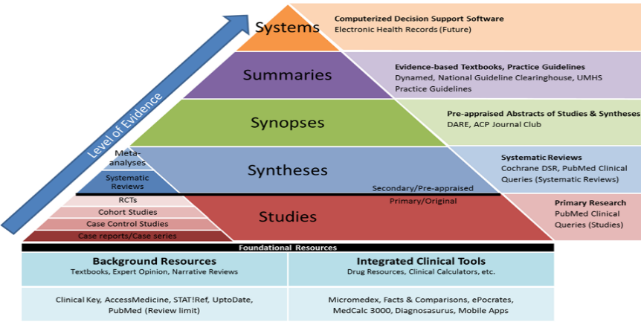
Evidence-Based Education
ARUMS
Nursing & Midwifery School
Workshop Target Group:
Professors and Educators

Slide 2
Workshop Outcomes:
Explaining the phrases used in Evidence-Based situations.
Mentioning the most related data-bases for Nursing evidences.
Determining the level of evidence for each study type.
Explaining the EBE principals.
Workshop Outline:
Evidence-Based Practice (EBP)
Evidence-Based Education (EBE)
Level of Evidence
Hierarchy of Evidence
Search for Evidence
The Cochrane Library
JBI Model of EBHC
Principles of EBE

Slide 3
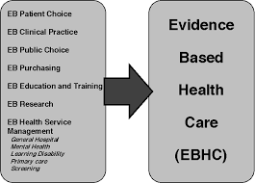
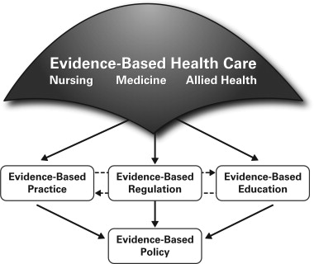

Slide 4
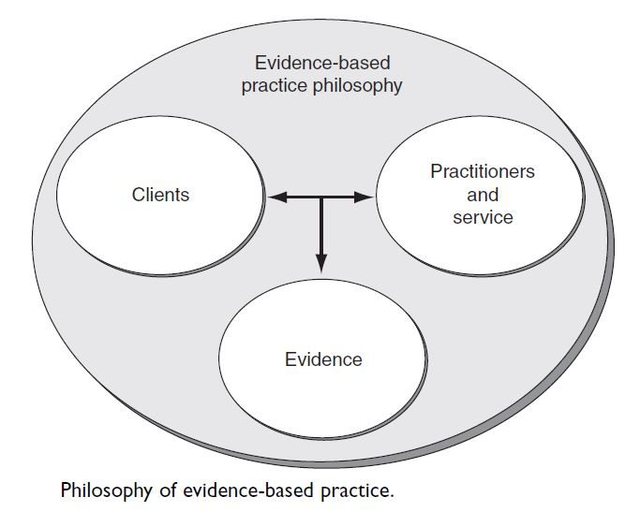
Evidence-Based Practice (EBP)
Notes:
Evidence-Based Practice (EBP), evolved over many years as the principles and process adopted by many disciplines in health and social care.
The aim of EBP is:
to do the right thing
at the right time
for the right person
in other words ensure quality care for the individual client.
This is achieved by evaluating ideas, practices and previous events and applying the learning achieved to future practice.
Evidence-Based Medicine (EBM) was coined and defined by Sackett et al in 1996 as:
The conscientious, explicit and judicious use of the current best evidence in making decisions about the care of individual patients.
As Sackett et al (2000) emphasize, EBP is more than just the best evidence, it is the integration of best evidence with high-quality clinical skills, such as communication and assessment, as well as the application of evidence to the particular belief systems, values and context of the client’s life.

Slide 5
Evidence Based practice (EBp)
The best available research evidence is challenging as it means best practice cannot conclusively and finally be established.
Evidence is forever changing in the light of new research, new technology, new ideas, as well as old ideas and options put together in new ways.
An important feature of EBP is the way it is dynamic and open to reviewing, its purpose to be a way of constantly updating practice.

Slide 6
Evidence-Based Education
Evidence-based education (EBE) is the principle that education practices should be based on the best available scientific evidence, with randomized trials as the gold standard of evidence, rather than tradition, personal judgment, or other influences.
The integration of professional wisdom with the best available empirical evidence in making decisions about how to deliver instruction.

Slide 7
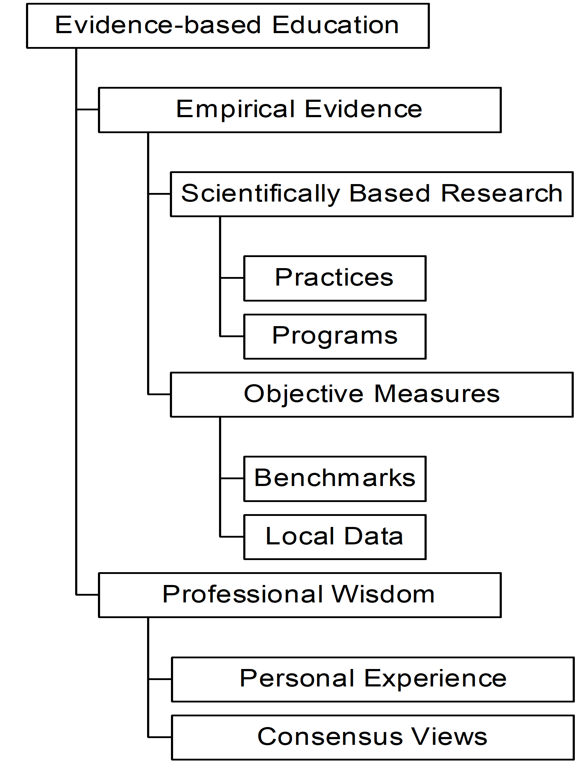
Evidence Based Education

Slide 8
Professional Wisdom
The judgment that individuals acquire through experience
Increased professional wisdom is reflected in numerous ways, including the effective identification and incorporation of local circumstances into instruction

Slide 9
Empirical Evidence
Scientifically based research from fields such as psychology, sociology, economics, and neuroscience, and especially from research in educational settings
Objective measures of performance used to compare, evaluate, and monitor progress

Slide 10
Why are both needed?
Without professional wisdom education cannot
adapt to local circumstances
operate intelligently in the many areas in which research evidence is absent or incomplete.
Without empirical evidence education cannot
resolve competing approaches
generate cumulative knowledge
avoid fad, fancy, and personal bias

Slide 11
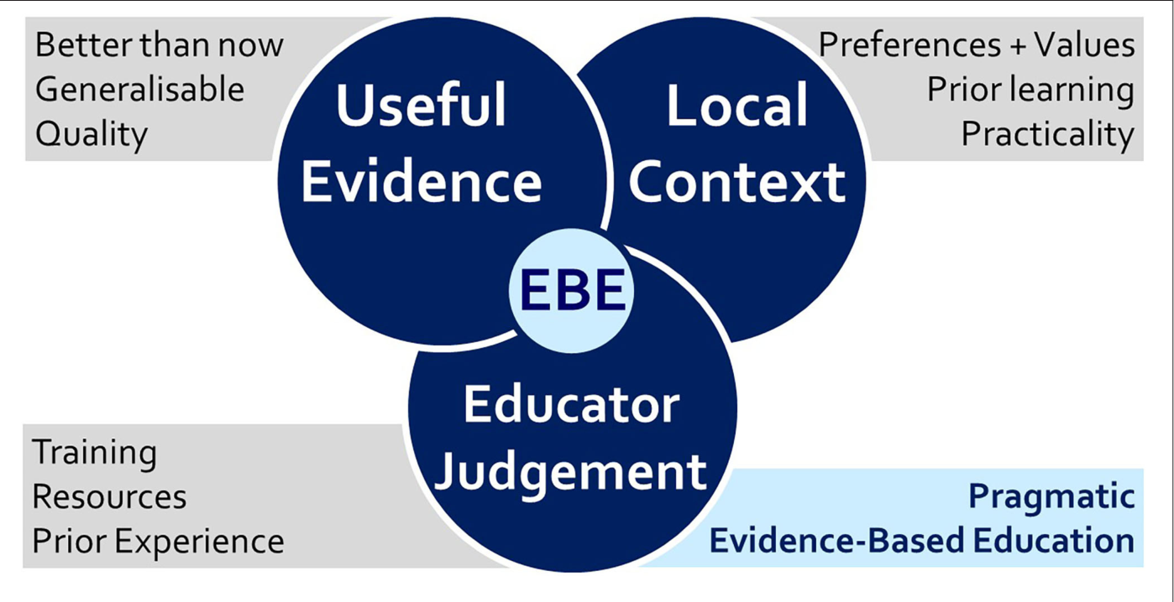

Slide 12
Healthcare System
Costly and complex health care system, causes in a greater emphasis on outcomes, cost-effectiveness, and consumer satisfaction.
Staff are challenged to:
maintain clinical competence, to demonstrate how their care positively affects patient outcomes.
participate actively in clinical decision-making and practice improvements in an environment of rapid information exchange, technological advancements, and an increasing nursing workload.
e.g. Nurses are now mandated to demonstrate cost-effectiveness and efficiency with the use of time and resources, while continuing to demonstrate their value-added impact on outcomes.

Slide 13
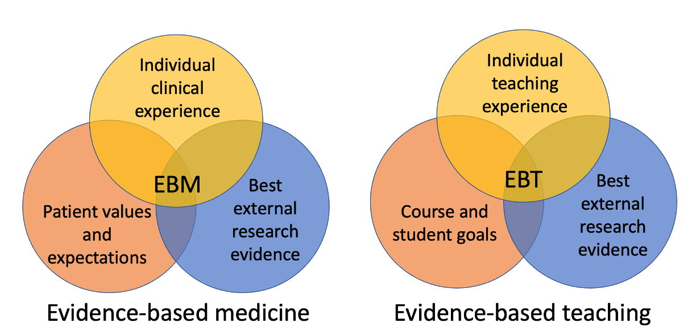

Slide 14
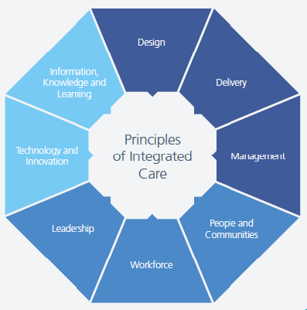

Slide 15
Level Of Evidence Hierarchy Of Evidence Search For Evidence
Search For Evidence

Slide 16
Level of Evidence
Literature is classified as primary or secondary.
Primary literature refers to original sources of information.
Secondary literature includes systematic reviews, reviews, guidelines/policies, editorials, opinions, critiques, and any information that is a reconsideration of primary data.
Published letters, for example, may be commenting on a previously published study, or provide original data from another unit supporting or refuting a study, or even highlighting a completely new point.

Slide 17
Grey Literature
There is also ‘grey’ literature, information that may be in the public domain but has not yet been published, and includes data/evidence held within theses, institutional reports and research data held by individual researchers.
Accessing grey literature is important, as there is a publication bias.
e.g.; thesis, dissertation, local language articles, not published studies, print published studies, …

Slide 18
Hierarchy of Evidence
Primary sources of evidence are considered superior to other forms of evidence and the most important primary source is research findings.
However, not all research is valued to the same degree.
This led to the development of a hierarchy of evidence, with an expectation that practitioners will base their practice on the best evidence as described by a hierarchy of evidence.

Slide 19
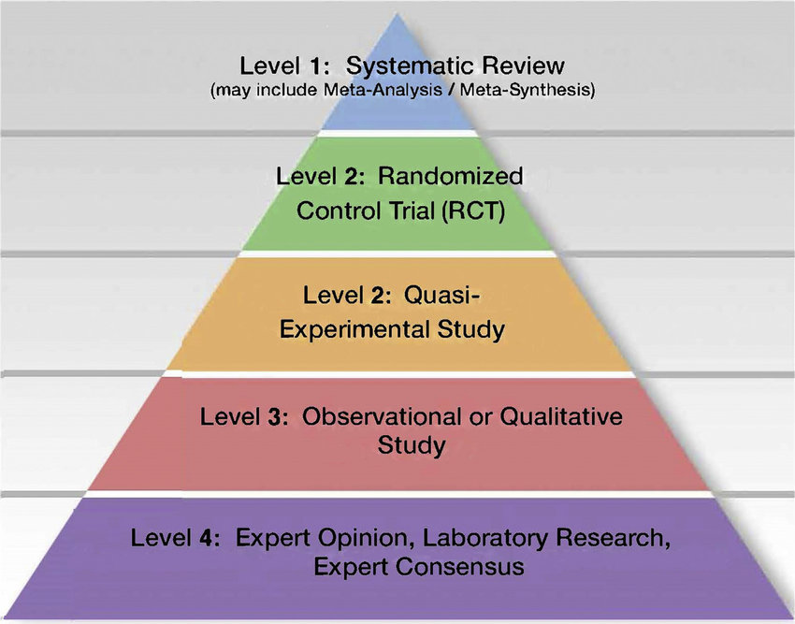

Slide 20
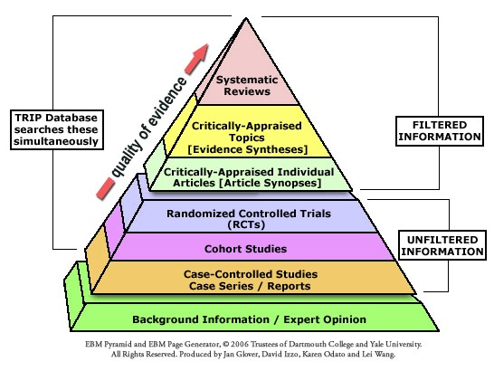
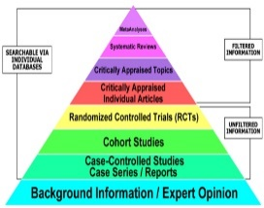

Slide 21
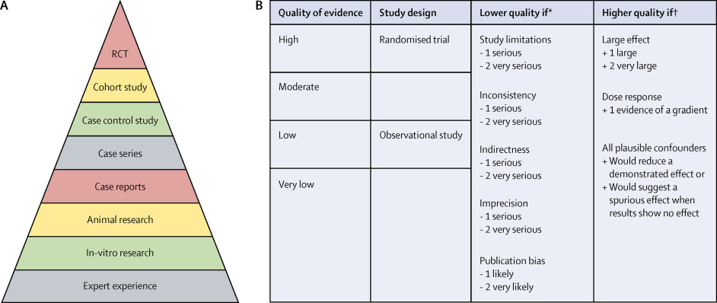

Slide 22
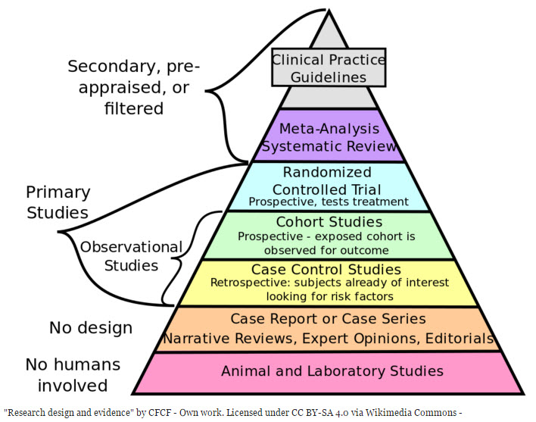

Slide 23
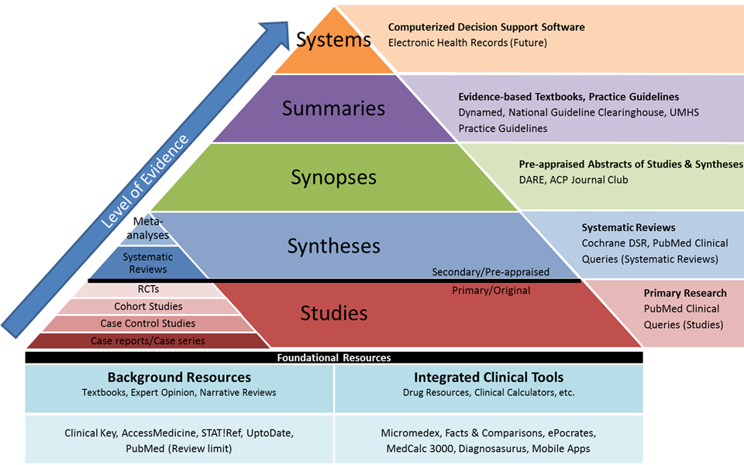

Slide 24
Search for Evidence
Searching and accessing the evidence
Search processes
(Linking word lists, Boolean logic: AND, OR, NOT)
Databases
(e.g.; Medline, CINAHL, ASSIA, BNI, PsycInfo, Scopus, ERIC, Campbell Collaboration, PsychInfo, etc)
Key words (Based on PICO)
Critical appraisal of the evidence
Using acceptable tools
(e.g.; Checklists of PRISMA, CONSORT, JBI, TREND, MMAT, STROBE, CASP, BEME, …)

Slide 25
The Cochrane Library
The Cochrane library Collaboration
Prepares
Maintains
Disseminates
systematic reviews of health care interventions focusing primarily on systematic reviews of controlled trials of therapeutic interventions.
(The Gold Standard For Experimental Research Design)

Slide 26
Search Question
Evidence is most easily achieved if the question is objective and clearly stated. Including the following four components helps achieve this:
a clearly identified client/group or condition
an intervention or issue (diagnostic test, care option)
a baseline or comparison point
an outcome or result.
To help recall these four features the mnemonic PICO may help:
P = person (originally patient) or target population
I = issue/intervention
C = comparison
O = outcome

Slide 27
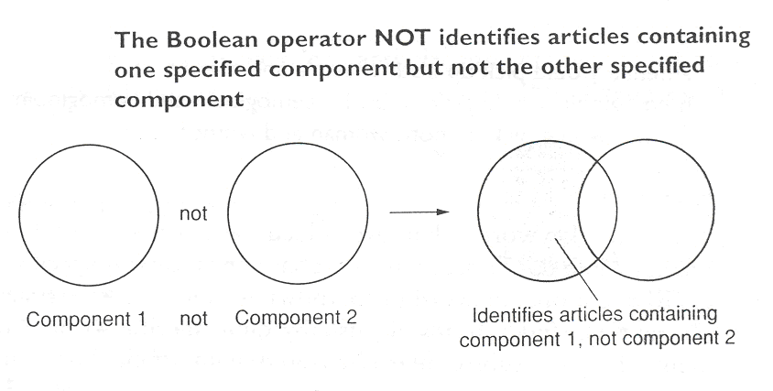
Boolean Operator AND, OR, NOT

Slide 28
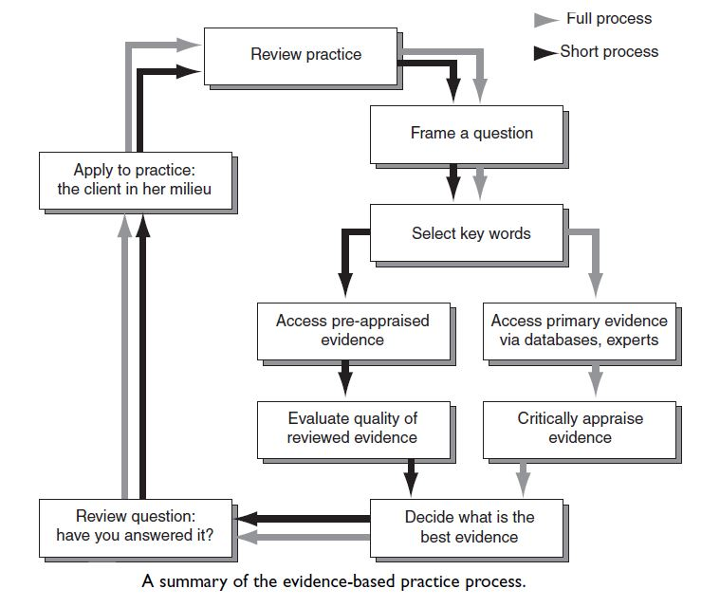

Slide 29
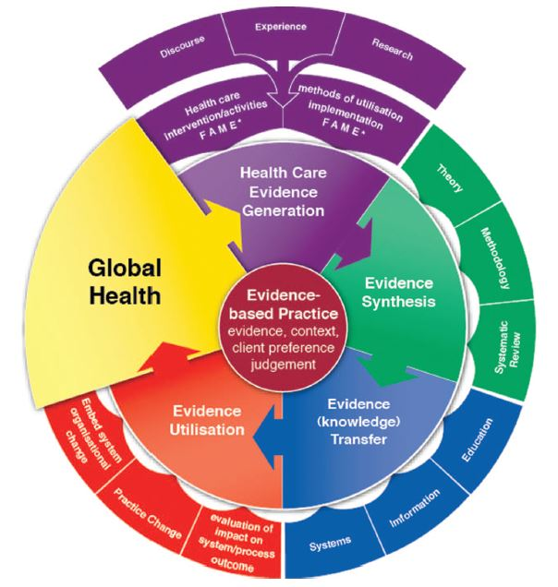
The Joanna Briggs Institute Model of Evidence-based Healthcare
The updated Joanna Briggs Institute Model of
Evidence-Based Healthcare
Zoe Jordan PhD, Craig Lockwood PhD, Zachary Munn PhD and Edoardo Aromataris PhD
DOI: 10.1097/XEB.0000000000000155
Int J Evid Based Healthc 2019; 17:58–71

Slide 30
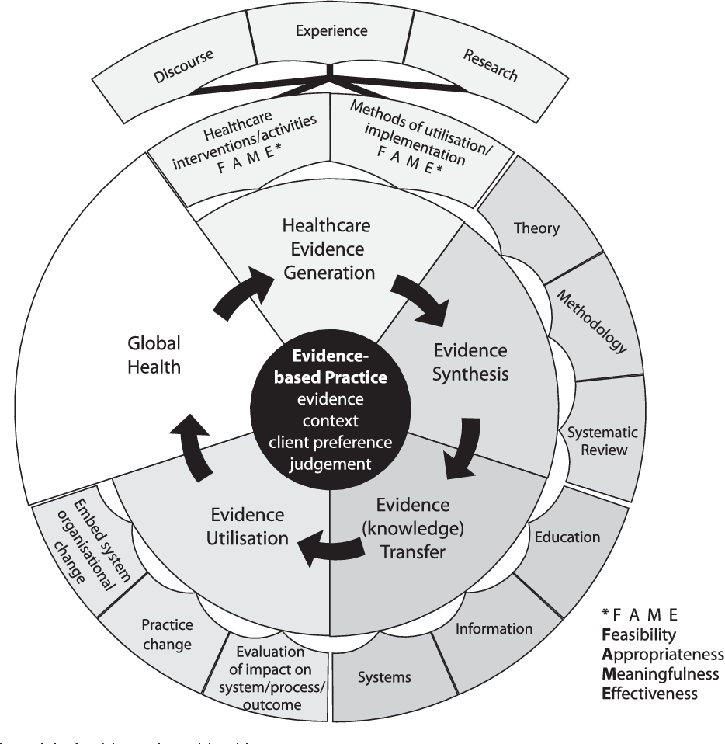
JBI Model of EBHC
JBI’s approach to evidence-based healthcare is unique.
JBI considers evidence-based healthcare as decision-making that considers the Feasibility, Appropriateness, Meaningfulness and Effectiveness (FAME) of healthcare practices.

Slide 31
JBI Model of EBHC
JBI regards evidence-based healthcare as a cyclical process.
What informs the process?
The best available evidence
The context in which care is delivered
The individual patient
The professional judgement
Expertise of the health professional
Global healthcare needs, as identified by clinicians or patients/consumers, are addressed through the generation of research evidence that is effective, but also feasible, appropriate and meaningful to specific populations, cultures and settings.
This evidence is collated and the results are appraised, synthesized and transferred to service delivery settings and health professionals who utilize it and evaluate its impact on health outcomes, health systems and professional practice.

Slide 32
Therefore, in order to provide those who work in and use health systems globally with world class information and resources, JBI:
considers international evidence related to the feasibility, appropriateness, meaningfulness and effectiveness of healthcare interventions (Evidence Generation)
includes these different types of evidence in a formal assessment called a systematic review (Evidence Synthesis)
globally disseminates information in appropriate, relevant formats to inform health systems, health professionals and consumers (Evidence Transfer)
has designed programs to enable the effective implementation of evidence and evaluation of its impact on healthcare practice (Evidence Implementation)
It is this unique approach that is encompassed in the JBI Model of Evidence-based Healthcare.

Slide 33
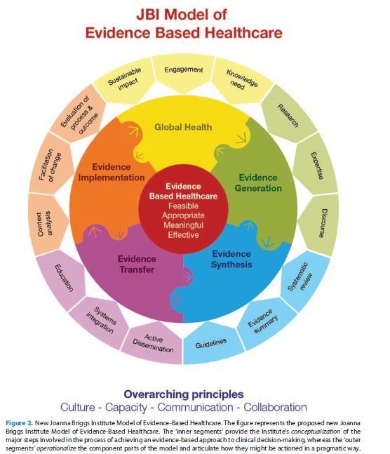
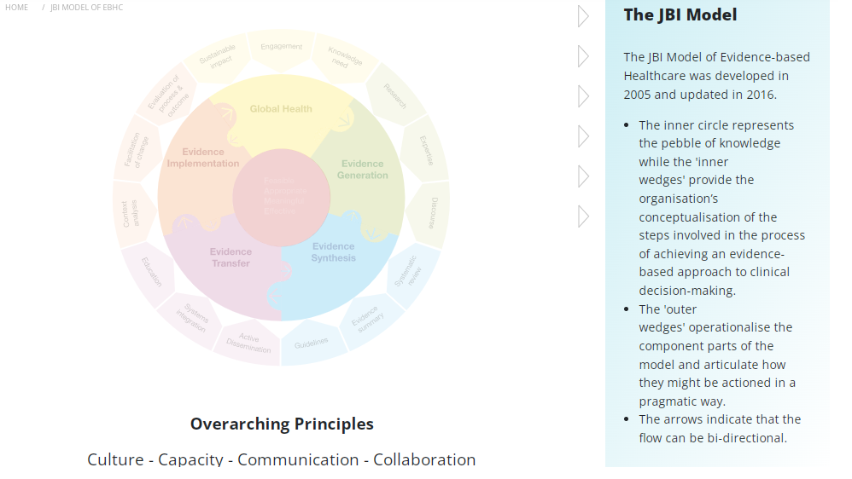

Slide 34
Principles of EBE:
Frequent contact with tutors/trainers
Cooperation and collaboration with other learners
Active involvement in thinking and learning
Engagement with prior knowledge and experience
Time on task in deliberate practice
Timely, specific feedback
A challenging, yet supportive, learning environment
Relevance to learners
Encouragement toward independent learning
Education is target group-centered

Slide 35
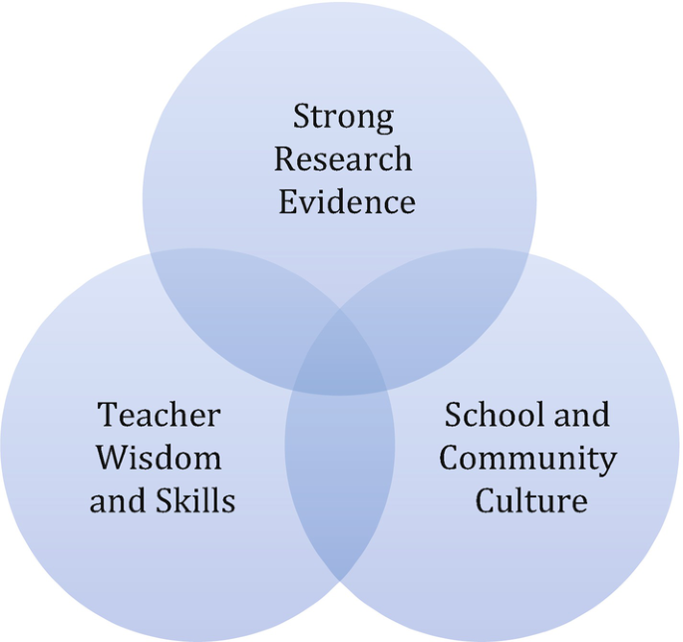

Slide 36
References:
Elizabeth R. Cluett. Evidence-based practice (Chapter 2). Principles and practice of research in midwifery (Book). 33-56.
DiCenso, A., Cullum, N. and Ciliska, D. (1998) ‘Implementing evidence-based nursing: some misconceptions’, Evidence Based Nursing, Vol.1, pp. 39-39.
Closs, S.J. and Cheater, F.M. (1999) ‘Evidence for nursing practice: a clarification of the issues’, Journal of Advanced Nursing, Vol.30, No.1, pp. 10-17.
Needham, G. (2000) ‘Research and practice: making a difference’ in Gomm, R. and Davies, C. (eds) (2000) Using Evidence in Health and Social Care, London, Sage Publications/Open University.
Kitson, A., Harvey, G. and McCormack, B. (1998) ‘Enabling the implementation of evidence based practice: a conceptual framework’, Quality in Health Care, 7, pp. 149-158.
Evidence Based Practice In Nursing. A presentation by Dr. Abdul-Monim Batiha, Assistant Professor, Critical Care Nursing, Philadelphia university.
Jordan Z, Lockwood C, Aromataris E, Munn Z. The updated JBI model for evidence-based healthcare. The Joanna Briggs Institute. 2016
Pearson A, Jordan Z & Munn Z. Translational science and evidence-based healthcare: a clarification and reconceptualization of how knowledge is generated and used in healthcare. Nursing Research and Practice. 2012.
Pearson A, Wiechula R, Court A & Lockwood C. The JBI model of evidence‐based healthcare, International Journal of Evidence‐Based Healthcare. 2005; 3(8):207-215.
http://www.ed.gov/offices/OERI/presentations/evidencebase.ppt - 277504 bytes - Fri Mar 15 12:15:53 EST 2002

